Slide 1
Microsoft Modern Datawarehouse Architecture
#Meetup - Les gentils développeurs Data Platform
Sauget Charles-Henri - MVP Data Platform
Ben Zahra Anouar – MVP AI
28/12/2019

Slide 2
SAUGET Charles-Henri
Consultant Data Platform depuis 2009
MAIL
chsauget@insiders.coop
GITHUB
https://github.com/chsauget
TWITTER
@SaugetCh
BLOG
www.sauget-ch.fr
WWW.INSIDERS.COOP

Slide 3
Anouar BEN ZAHRA
Consultant Data Platform
MAIL
Abenzahra@insiders.coop
GITHUB
https://github.com/AnouarBenZahra
TWITTER
@Anouarbenzahra
NUGET PACKAGE
https://www.nuget.org/profiles/Anouar
WWW.INSIDERS.COOP

Slide 4
Notes:
You are data engineer?

Slide 5
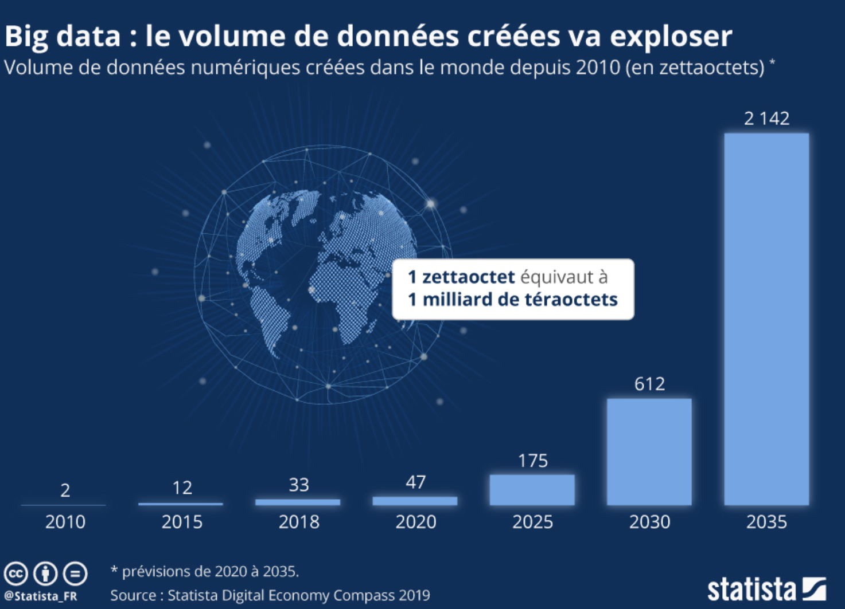
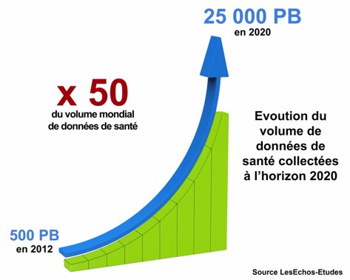
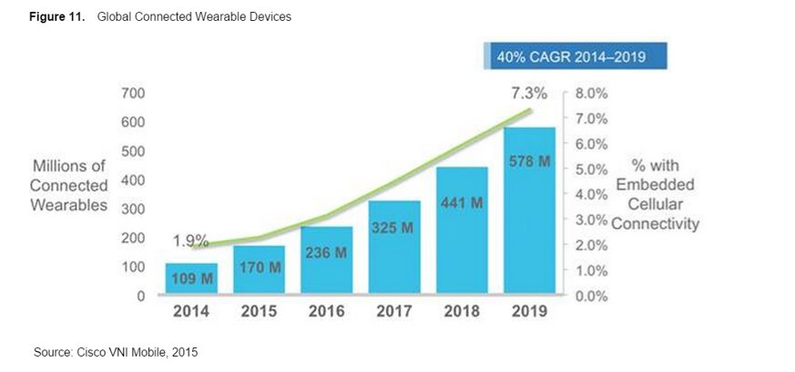
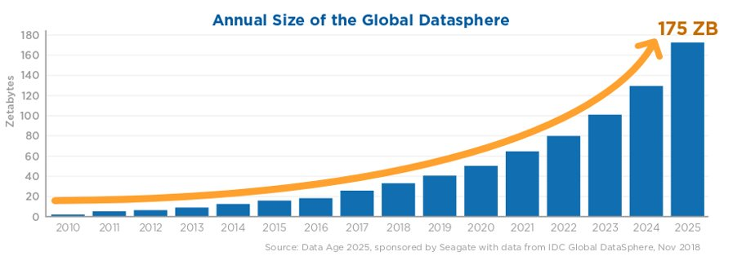
Data Evolution
Notes:
https://fr.statista.com/infographie/17800/big-data-evolution-donnees-numeriques-creees-dans-le-monde/
=> Data mining …

Slide 6
Data Abundance
Variety - Support large types of datas:
Structured (Tables)
Semi-Structured (Json)
Unstructured (Images)
Volume
Small data (<10gb)
Medium range data (10gb to 1 tb)
Big Data (>1tb to hundred of petabyte)
Velocity
Capacity to handle a large throughput (Gb/s ?)
Elasticity of the architectures

Slide 7
Structured vs unstructured Data

Slide 8
On-Premise vs Cloud
Computing Environment
Licensing Model
Maintainability
Scalability
Availability

Slide 9
Data Warehousing evolution

Slide 10
Data Engineering job responsibilities
The technology changed
So does the job!
New skills for new platforms
Changing loading approaches
From implementing to provisioning

Slide 11
Modern Data Warehouse Architecture
Separation of Storage & Compute
https://azure.microsoft.com/fr-fr/solutions/architecture/modern-data-warehouse/

Slide 12
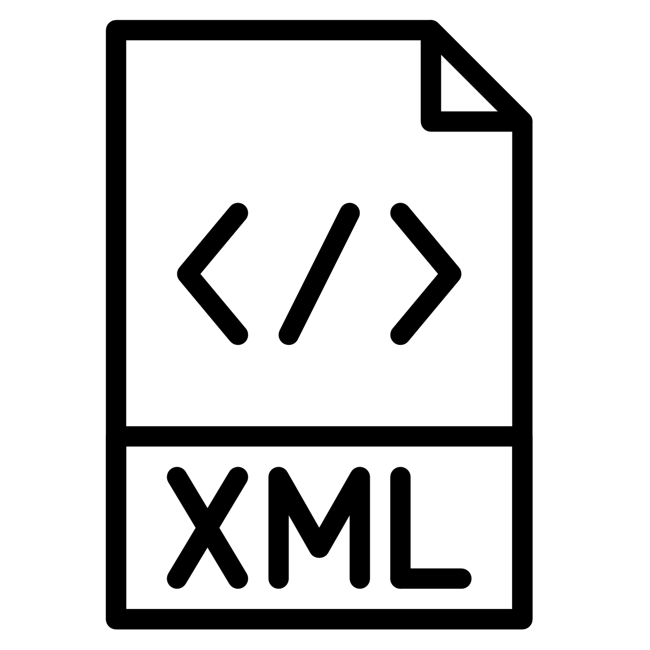
DEMO – Modern DWH
Lake gen2
Lake gen2
Comments.xml
(20 go)
Parquet Files
Azure Synapse
Power BI Azure AS
Users.xml
(3 go)
Azure Data Factory

Slide 13
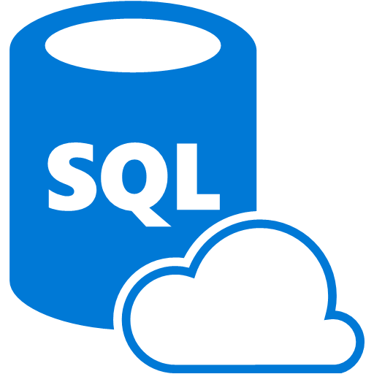
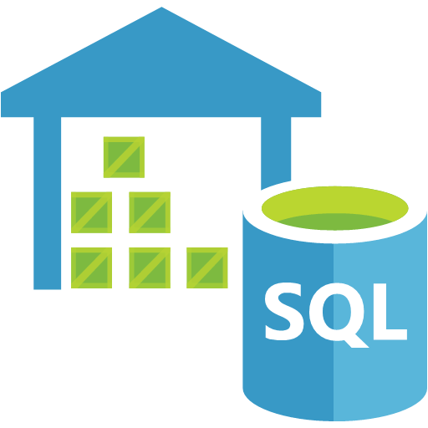
Our demo architecture
When you need a low cost, high throughput data store.
When you need to store No-SQL data.
When you do not need to query the data directly. No ad hoc query support.
Suits the storage of archive or relatively static data.
Suits acting as a HDInsight Hadoop data store.
When you need a low cost, high throughput data store.
Unlimited storage for No-SQL data
When you do not need to query the data directly. No ad hoc query support.
Suits the storage of archive or relatively static data.
Suits acting as a Databricks , HDInsight and IoT data store.
Eases the deployment of a Spark based cluster.
Enables the fastest processing of Machine Learning solutions.
Enables collaboration between data engineers and data scientists.
Provides tight enterprise security integration with Azure Active Directory
Integration with other Azure Services and Power BI.
When you require a relational data store.
When you need to manage transactional workloads
When you need to manage a high volume on inserts and reads
When you need a service that requires high concurrency
When you require a solution that can scale elastically
When you require a relational data store.
When you need to manage analytical workloads
When you need low cost storage.
When you require the ability to pause and restart the compute.
When you require a solution that can scale elastically

Slide 14
Our demo architecture
When you require a fully managed event processing engine.
When you require temporal analysis of streaming data.
Support for analyzing IoT streaming data.
Support for analyzing application data through Event Hubs.
Ease of use with a Stream Analytics Query Language.
When you want to orchestrate the batch movement of data.
When you want to connect to wide range of data platforms.
When you want to transform or enrich the data in movement.
When you want to integrate with SSIS packages.
Enables verbose logging of data processing activities.
When you require documentation of your data stores.
When you require a multi user approach to documentation.
When you need to annotate data sources with descriptive metadata.
A fully managed cloud service whose users can discover the data sources.
When you require a solution that can help business users understand their data.

Slide 15
DEMO –Streaming
Lake gen2
Lake gen2
Comments.xml
(20 go)
Parquet Files
Azure Synapse
Power BI Azure AS
Users.xml
(3 go)
Avro Files
Twitter data
#Azure
#SynapseAnalytics
Event Hub
Stream
Analytics
Power BI Stream
Azure Data Factory

Slide 16
DEMO –Streaming
Lake gen2
Power BI Direct Query
Lake gen2
Comments.xml
(20 go)
Parquet Files
Azure Synapse
Power BI Azure AS
Users.xml
(3 go)
Avro Files
Twitter data
#Azure
#SynapseAnalytics
Event Hub
Stream
Analytics
Power BI Stream
Azure Data Factory

Slide 17
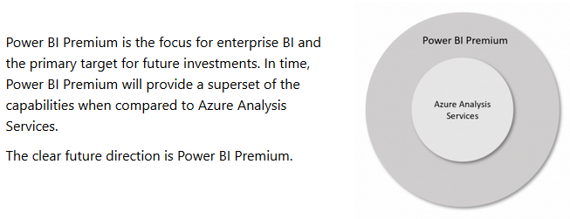
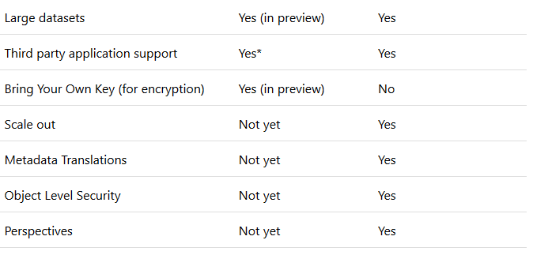
Power BI Premium vs Azure AS ?
https://powerbi.microsoft.com/en-us/blog/power-bi-premium-and-azure-analysis-services/

Slide 18
Synapse future
Data
Develop
Orchestrate
Monitor

Slide 19
SQL 2019 – Big Data Cluster
Same capabilities than previous architecture but… on-premise!

Slide 20
SQL 2019 – Big Data Cluster
Supported by K8S infrastructure!

Slide 21
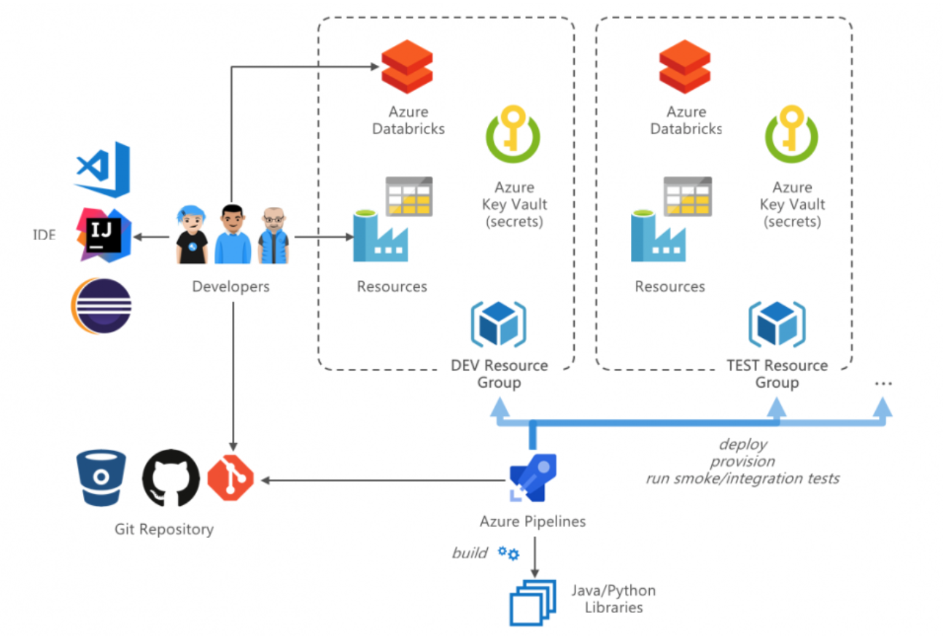
CI/CD

